Slide 1

Minneapolis Temperature - Crime Analysis
Prakrit Sinha, Khushi Goyal, Jithendra Jagannatha Kagathi, Akshara Madhu Suthanan
CSCI 5707 PROJECT 2023

Slide 2
TABLE OF CONTENTS
01
02
03
INTRODUCTION
DATA PREPROCESSING
DATASET & TOOLS
04
05
06
IMPLEMENTATION & HYPOTHESIS TESTING
DATABASE DESIGN
CONCLUSION
Description of the topic and goal of the project
Information on dataset and tools used
Data preprocessing and mapping
ER Diagram for the tables
Analysis of the Trends
Conclusion drawn

Slide 3
01
INTRODUCTION

Slide 4
Crime in the United States incurs significant costs, with a single homicide costing over $8.9 million, a robbery over $42,000, and a burglary over $6,000. Beyond the financial impact, crime victims often suffer long-term mental health issues, with about 25% experiencing post-traumatic stress disorder. Additionally, the fear of crime adversely affects individuals' mental and physical health. Researchers explore various factors contributing to criminal behavior, including income, education, and intelligence, with some investigating less obvious connections such as weather and temperature.

Slide 5
MOTIVATION & GOAL
Efficient resource allocation for law enforcement based on weather-related crime patterns.
Finding the relation between temperature and crime in the city.
Enhancing understanding of human decision-making in crime through weather-related analysis.

Slide 6
STEPS INVOLVED
STEP 01
STEP 02
STEP 03
STEP 04
DATA COLLECTION & PREPROCESSING
DATABASE DESIGN
KEY QUESTIONS & ANALYZING TRENDS
HYPOTHESIS TESTING

Slide 7
02
DATASET & TOOLS USED

Slide 8
TOOLS USED
JUPYTER NOTEBOOK
NUMPY
PANDAS
MYSQL
SEABORN
R
Data Preprocessing
Cleaning and analyzing data
Perform math and matrix operations
Creating visualizations
Hypothesis testing
Database creation and answering questions

Slide 9
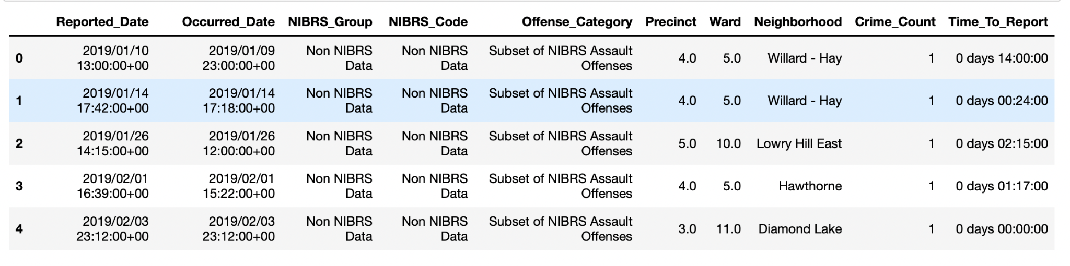
DATASETS
Dataset 1: Minneapolis Crime Dataset dataset

Slide 10
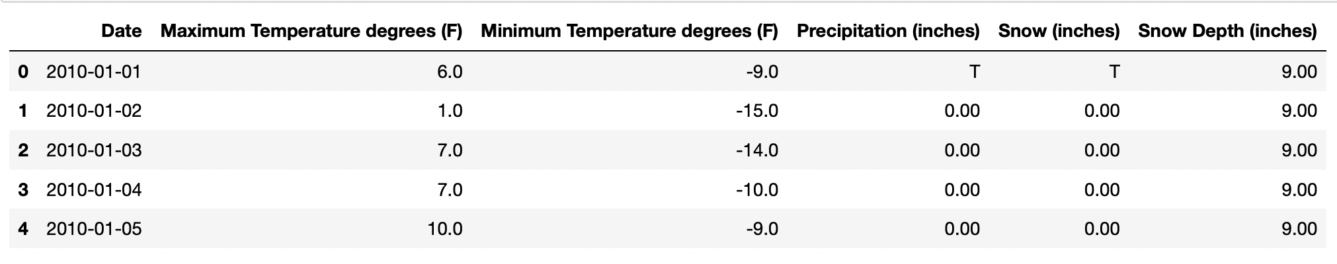
Dataset 2: Minneapolis Temperature Dataset dataset

Slide 11
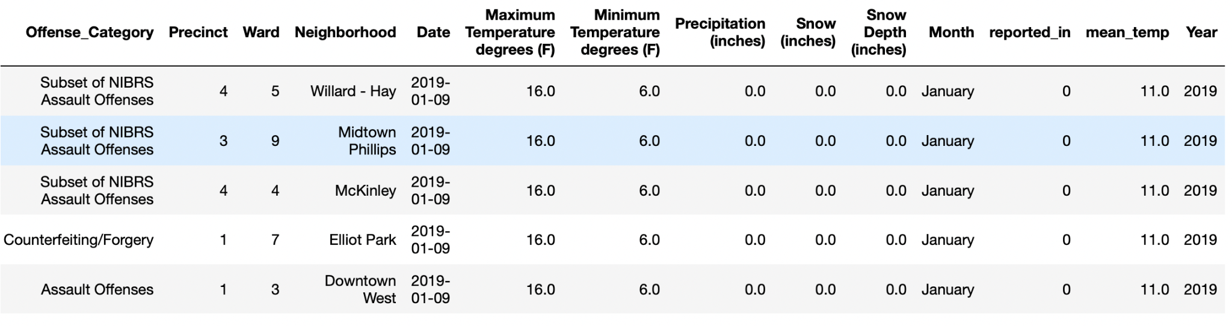
Final preprocessed and merged dataset

Slide 12
03
DATA PREPROCESSING

Slide 13
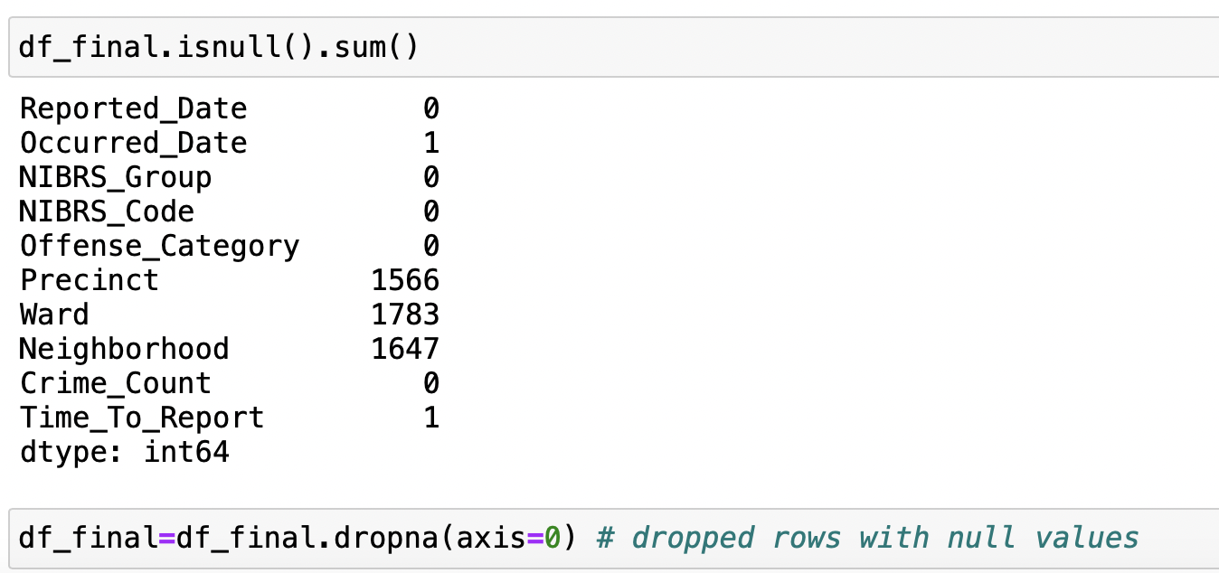
DATA PREPROCESSING
Dropped irrelevant attributes from Crime Dataset, hence reducing columns from 24 to 10.
Dropped null values. As they were very few in percentage it was better to remove them than using some impute technique.

Slide 14
In temperature dataset, there were no null values but for the ‘Snowfall’ attribute there was a value denoted by ‘T’ , which was making this numerical column behave as a string object. Upon further research we found out that ‘T’ denoted trace values: snowfall levels which were not 0, but some slight quantity not possible to measure with the devices. Hence we replaced all trace values into ‘0’ and changed this column to type float.
The date columns were of object type so we converted them to the appropriate date format (YYYY-MM-DD).
After cleaning the two datasets we merged them on Date.
We had a lot of data (from 2013), but our study interest was only for the most recent years (2019-2022). So we ordered our data and sliced the dataset for our target range.

Slide 15
Furthermore, to efficiently write queries and generate plots, we engineered some new columns:
Month: We extracted the month out of the Date column and mapped it to their character value.
Year: We also extracted year out of the Date column.
Mean_Temperature: We built a new attribute by taking the mean of high and low temperature attributes.
Our time_to_report column had date in the format of #days, HH,MM,SS, so we converted it strictly into days. If crime was reported the same day, it took a value of 0.

Slide 16
04
DATABASE DESIGN

Slide 17
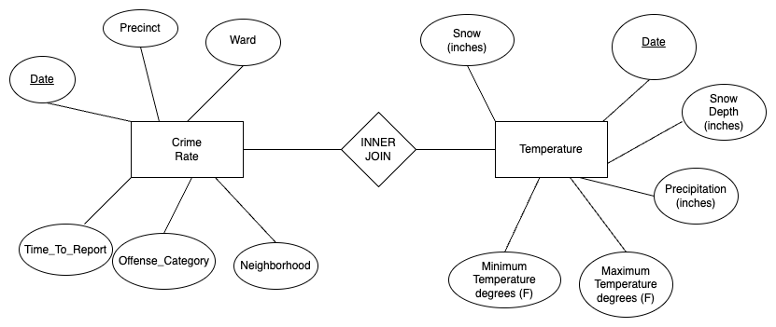
E R - DIAGRAM

Slide 18
ANALYSIS & KEY QUESTIONS

Slide 19
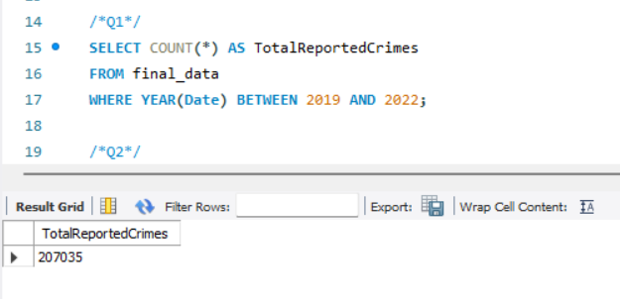
List the total number of reported crimes between 2019 and 2022.

Slide 20
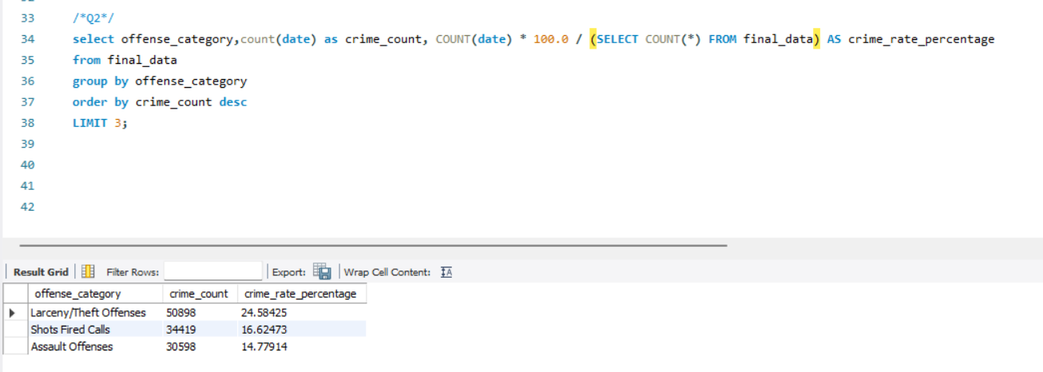
What are the 3 most common crimes reported and what percentage amount are they of the total amount of reported crimes?

Slide 21
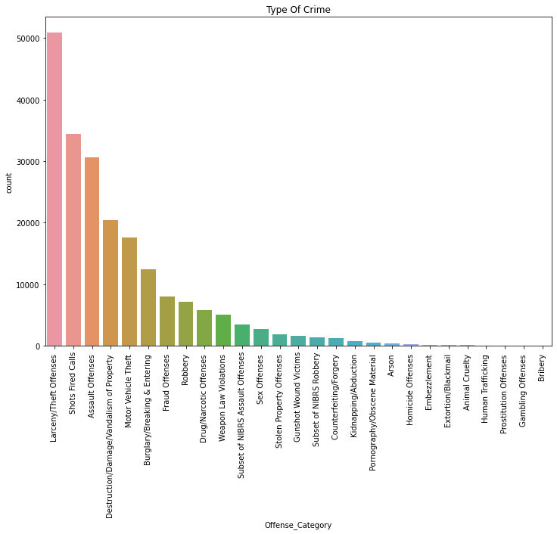

Slide 22
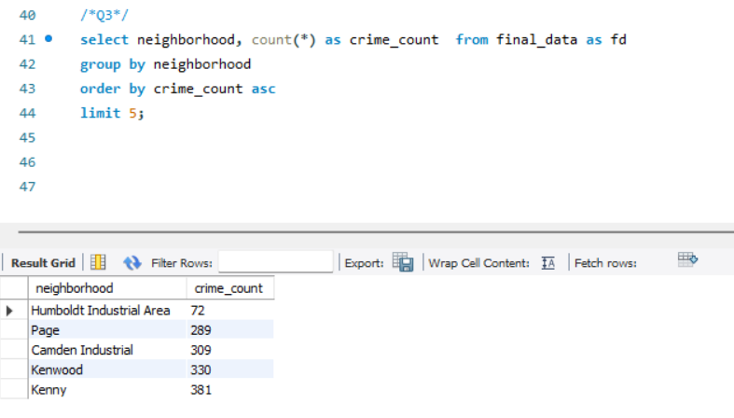
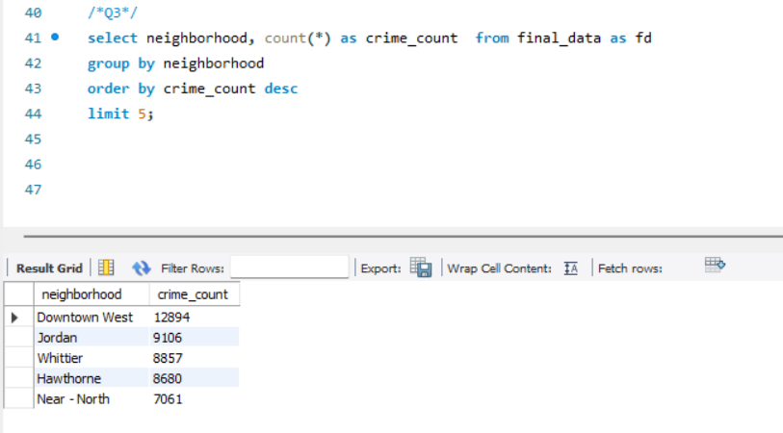
What are the top 5 neighborhoods that had the MOST and the LEAST number of crimes reported?

Slide 23
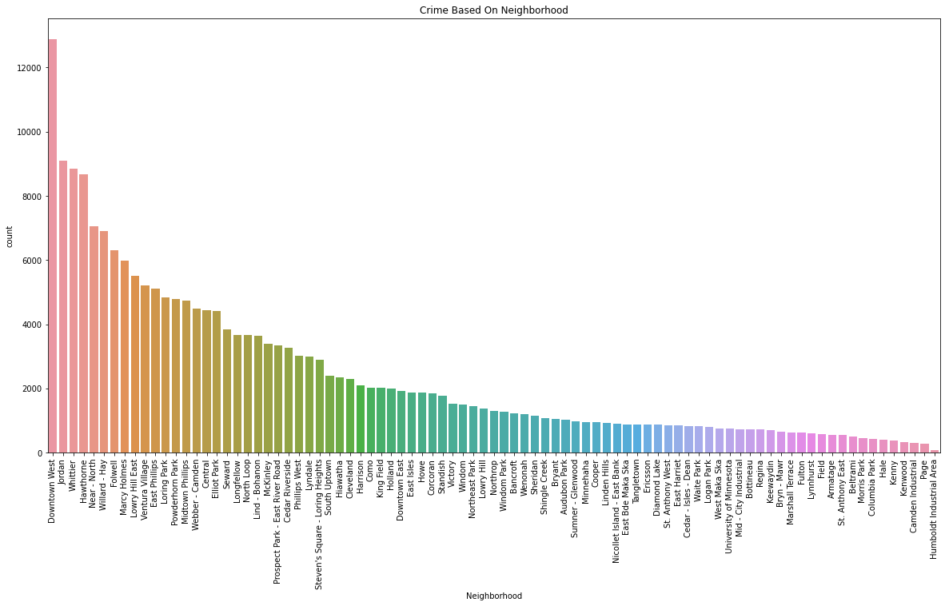

Slide 24
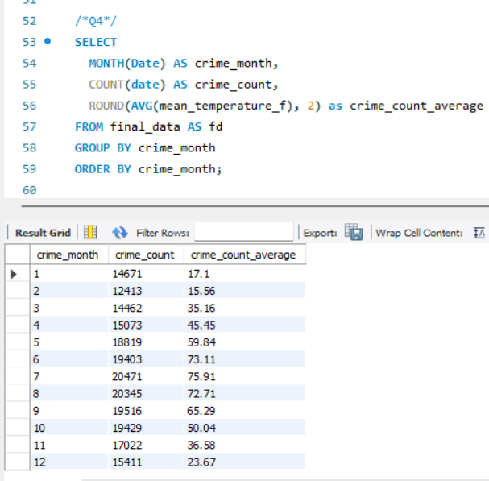
What month had the most crimes reported and what was the average temperature per month in the last four years?

Slide 25
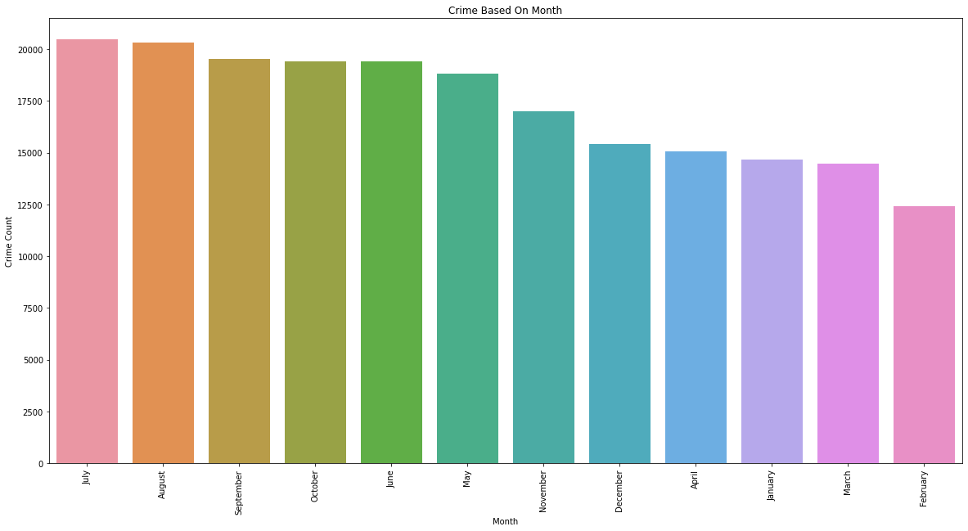

Slide 26
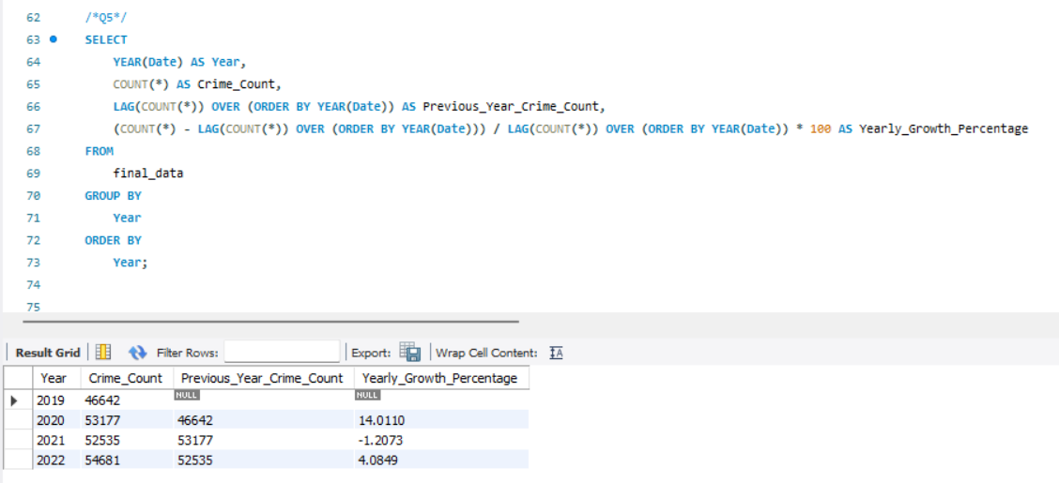
What is the yearly percentage change in the crime rate over the past 4 years?

Slide 27
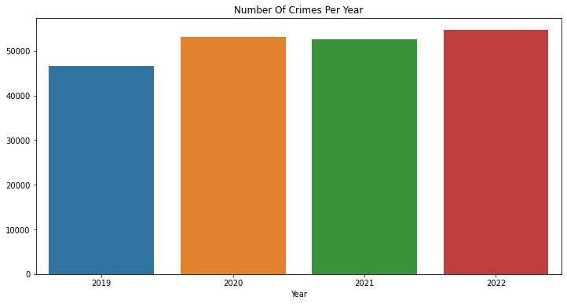

Slide 28
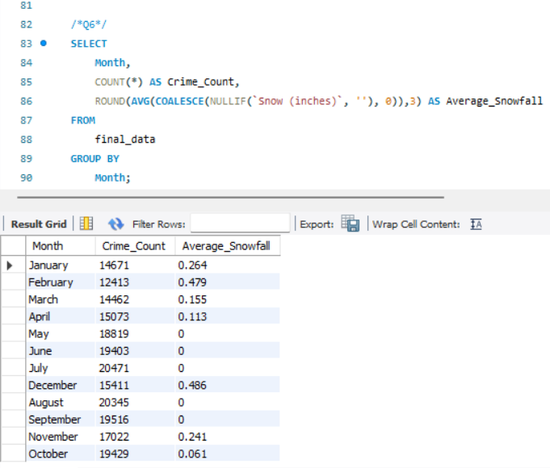
List the month and the average snowfall with the corresponding number of crimes.

Slide 29
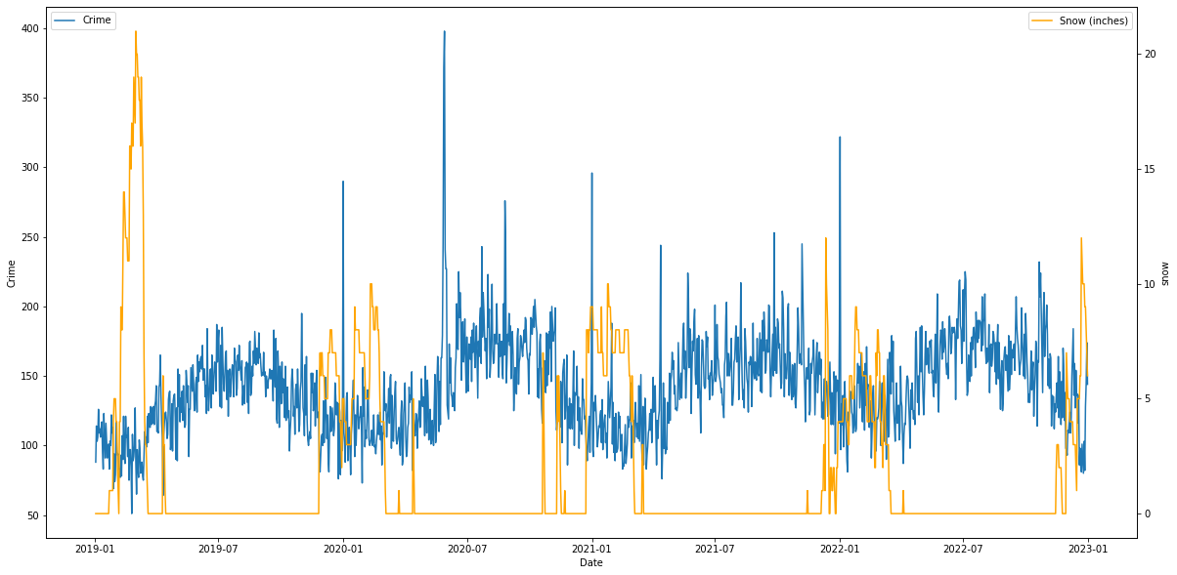

Slide 30
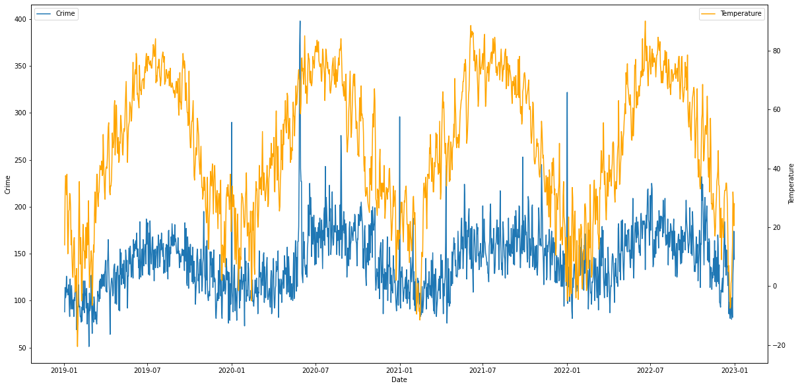
Is there a relationship between crime rate and temperature? Support with a graphic.

Slide 31
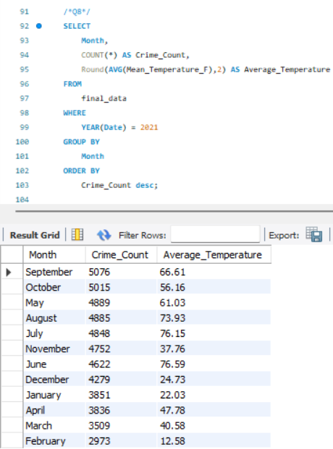
For the year 2021, list the number of crimes reported monthly, and what was the average temperature for each month during the year?

Slide 32
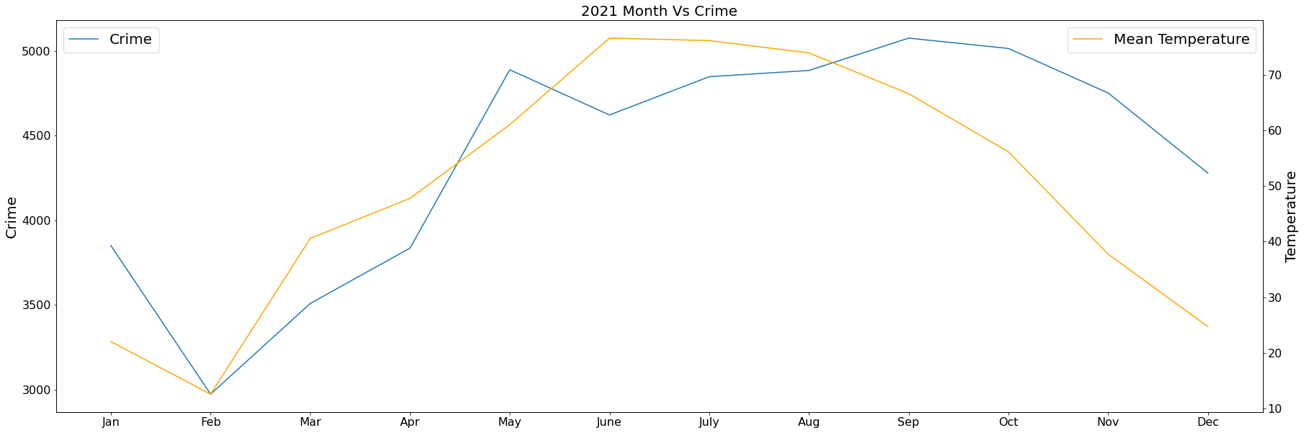

Slide 33
05
HYPOTHESIS TESTING

Slide 34
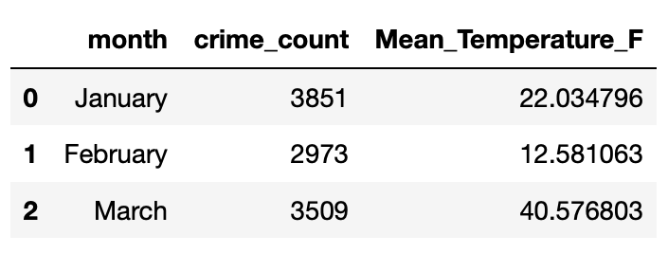
By now, it is pretty clear that temperature and crime rate in the city of Minneapolis are positively correlated. We will now conduct a basic hypothesis test to formalize this insight.
As our data is cyclic in nature, if we take the whole data it would not be ideal to fit a SLR model to it. Hence, we are just conducting the test for the year 2021.
We have transformed our data a bit for this experiment. As we want to keep it simple, we have taken monthly data for the year of 2021. Each month has a total crime count and a mean temperature for that month.
Final data was as following:

Slide 35
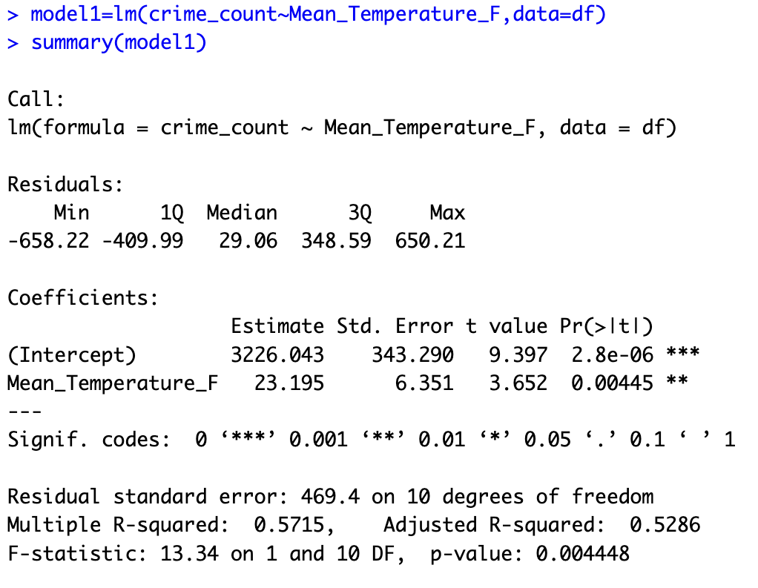
We tried a SLR model with crime_count as the response and mean_temperature as the predictor. For this test:
Null hypothesis: Coefficient of mean_temperature is not statistically significant and thus = 0.
Alternative hypothesis: Coefficient of mean_temperature is statistically significant and hence != 0.

Slide 36
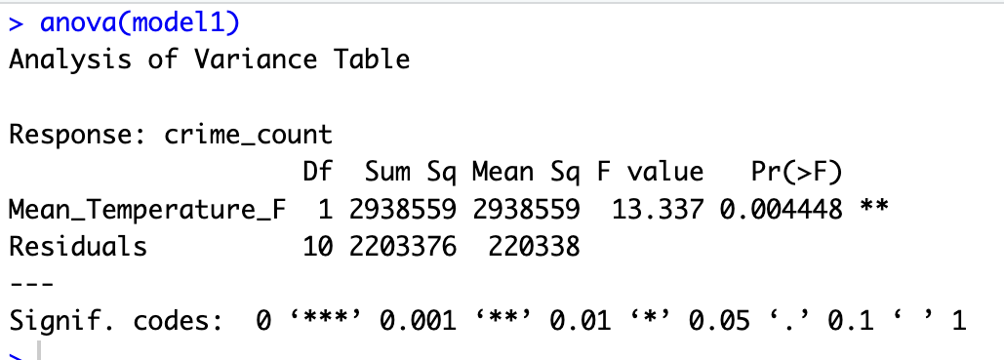
From the figure in the last slide, we can see that both the coefficients are statistically significant.
Let us conduct an ANOVA test to formalize this even further:
The ANOVA in this figure is testing our null against the alternative hypothesis. As the p value <0.05, we can successfully reject the null hypothesis and accept the alternative hypothesis. Hence we can conclude that mean_temperature is statistically significant.

Slide 37
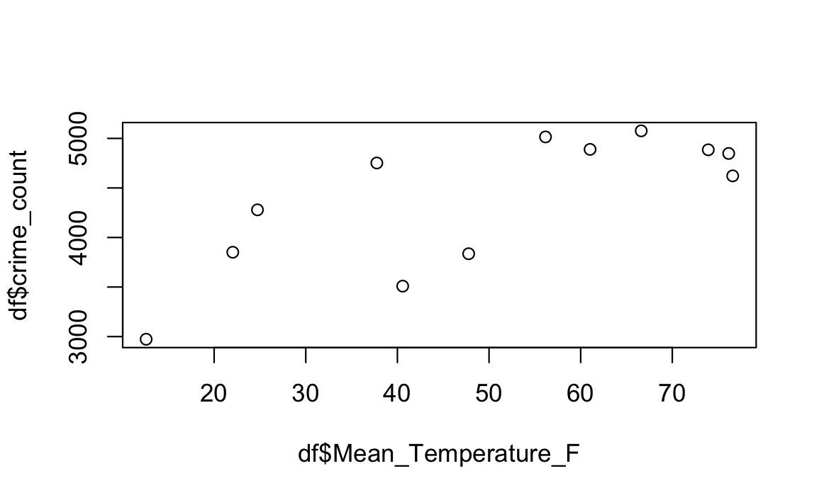
ASSUMPTIONS FOR LINEAR REGRESSION ANALYSIS
Here are the four assumptions for our SLR model:
Linearity: We assume that our data is linear to a high extent.
Independence: We assume that our residuals are independent of each other.

Slide 38
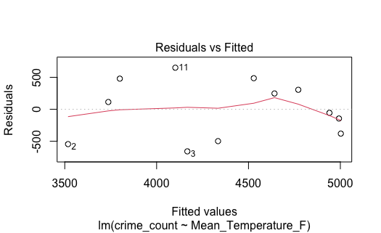
Assumptions contd…
Homoscedasticity: We assume that the residuals of our data have constant variance. We can check for constant variance by plotting residual Vs fitted values for the model. The assumption of constant variance holds if the points are distributed randomly, showing no pattern. From the plot below, we can see this is more or less the case for our data.

Slide 39
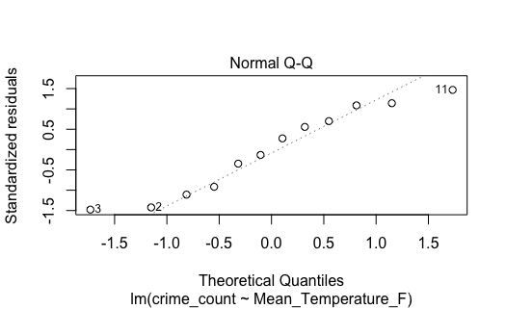
Assumptions contd…
Normality: The residuals are assumed to be normally distributed. We can check for this by plotting a Q-Q plot. Its a plot between standardized residuals Vs the theoretical quantiles. The points plotted should fall on the Q-Q line. From the plot below, that is almost the case.

Slide 40
06
CONCLUSION
The graphical analysis reveals a notable direct relationship between temperature and crime rates in Minneapolis.
A pronounced decrease in crime rates is evident during periods of heavy snowfall and lower temperatures.
This trend is particularly noteworthy during the winter months, suggesting a correlation between climatic conditions and criminal offenses in the city.
When crime vs temperature was fit as linear model, it yielded a statistically significant predictor coefficient. Further so, with the help of ANOVA we were able to reject the null hypothesis (temperature not significant), and accept the alternative hypothesis.

Slide 41
THANKS

